Slide 1
Route Optimization
Based On Crowd Sourced Data
Collaboration and Class Diagram
Group Members:
1405009
1405013
1405014
1405015
1405016

Slide 2
We divided our whole system into 3 subsystems:
Registration/LogIn Subsystem
Traffic Update Subsystem
Route Proposal Subsystem

Slide 3
Registration/LogIn Subsystem
Use Case | Actor(s)
Register | User, Media
Log In | User, Media
Log Out | User, Media
Restore Password | User, Media

Slide 4



8.VerifyEmail()
2.ProvideData()
10.SendNotification()
7.SendEmail()
1.ShowRegPage()
3.CheckData()
User/Media
:RegisterUI
:Register
4.GetUserData()
9.VerifyAccount()
5.StoreData()
Collaboration Diagram
for Register Use Case
:User
:RegistrationInfo
6.StoreData()

Slide 5
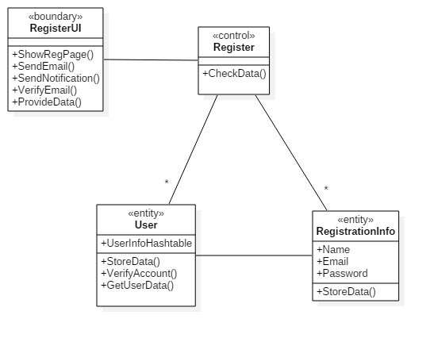
Class Diagram for
Register Use Case

Slide 6
3.ProvideLogInData()
6.ShowHome()
5(b).ShowError()
2.ShowLogIn()
4.VerifyLogIn()
User/Media
:LogInUI
:LogIn
1.GetRegData()
5(a).GetUserInfo()
Collaboration Diagram
for Log In Use Case
:User
:RegistrationInfo

Slide 7
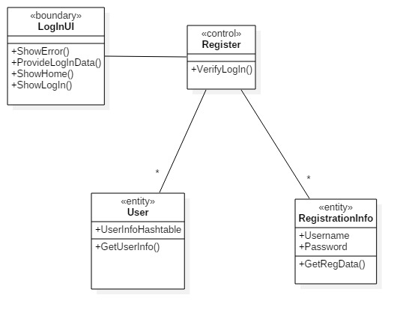
Class Diagram for
Log In Use Case

Slide 8
2. Traffic Update Subsystem
Use-Case | Actor(s)
Update | User, Media, Admin
Undo | User, Media, Admin

Slide 9
5.ShowLocation()
2.ShowMap()
8.ProvideSeverity()
6.SetDirection()
:Update
9.ProvideSeverity()
7.SetDirection()
:UpdateUI
User
12.StoreData()
11.CheckValidity()
10.GetCurrData()
1.GetMap()
Collaboration Diagram
For Update Use Case
14.SetCoin()
13.SetIntegrity()
3.GetLocation()
:TrafficInfo
:User
4.GetLocation()
:Map

Slide 10
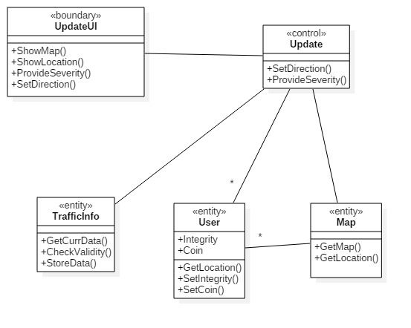
Class Diagram for
Update Use Case

Slide 11
3. Route Proposal Subsystem
Use-Case | Actor(s)
Get Direction | User
Show Current Situation | User

Slide 12
11.ShowBestRoute()
6.GetDestination()
3.GetStartPoint()
2.ShowMap()
7.SetDestination()
4.SetStartPoint()
:GetDirection
5. SetStartPoint()
8.SetDestination()
User
:GetDirectionUI
10.GetPrevData()
9.GetCurrData()
1.GetMap()
Collaboration Diagram
For Get Direction Use Case
12.DecreaseCoin()
:TrafficInfo
:User
:Map

Slide 13
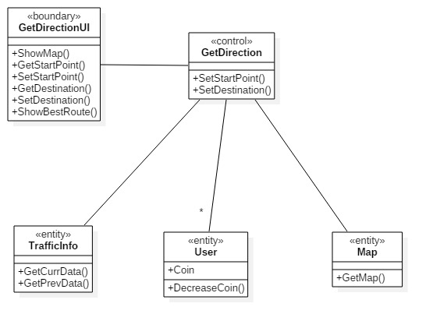
Class Diagram for
GetDirection Use Case

Slide 14
6.ShowTrafficStatus()
4.ShowMap()
1.ShowCurrentSituation()
:ShowCurrSituation
2.ShowCurrentSituation()
User
:ShowCurrSituationUI
5.GetAllCurrData()
3.GetMap()
Collaboration Diagram
For Show Current Situation
Use Case
:TrafficInfo
:Map

Slide 15
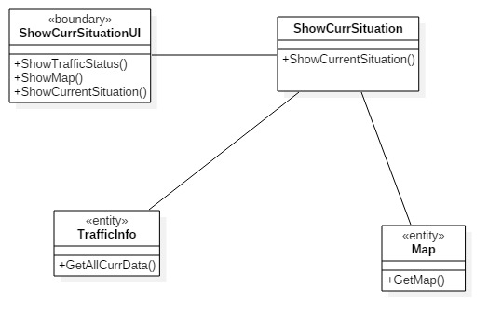
Class Diagram for
Show Current Situation

Slide 16
Thank You

